Slide 1

END-TO-END ANALYTICS JOURNEY
Supportlytics
Data-Driven Optimization of IT Support Team Performance
● Module 1–2 · Foundation
● Module 3–4 · EDA & Clustering
● Module 5–6 · Performance & Geo
● Module 7–8 · Dashboard & Delivery
Prepared by N Sai Srimannarayana
Milestones 1–4 · Weeks 1–8 · 200,000-ticket dataset · Python + Power BI

Slide 2
PROJECT ROADMAP
Eight Modules, Four Milestones
From raw ticket data to an executive Power BI dashboard — every module builds on the one before it.
Milestone 1
Milestone 2
Milestone 3
Milestone 4
Week 1–2
Week 3–4
Week 5–6
Week 7–8
1
3
5
7
Module 1
Module 3
Module 5
Module 7
Project Initialization & Dataset Setup
Exploratory Data Analysis
Performance Trend Analysis
Dashboard / Report Preparation
2
4
6
8
Module 2
Module 4
Module 6
Module 8
Data Cleaning & Feature Engineering
Business Clustering & Similarity
Geographic & Category Insights
Documentation & Presentation
Supportlytics · Modules 1–8 Journey
2

Slide 3
BUSINESS CONTEXT
The Problem & The KPI Framework
Identify patterns in support demand and performance to recommend workflow and resource-allocation improvements.
Objective
Ten KPIs Anchor Every Module
Analyze IT support ticket data to identify key performance trends, optimize resolution times, and enhance service efficiency — uncovering patterns in requests, technical issues, and support performance to recommend workflow and resource-allocation improvements.
1
2
Avg Resolution Time
First Response Time
3
4
SLA Breach Rate
Escalation Rate
Analytical Workflow
1
Acquire & understand data
5
6
Customer Satisfaction (CSAT)
Ticket Volume by Priority/Category
2
Clean & engineer features
7
8
3
Explore demand patterns
Open / Backlog Rate
Repeat Contact Rate
4
Cluster related issues
9
10
5
Analyze performance
Issue Complexity Index
Cluster / Similarity Concentration
6
Build the dashboard
Supportlytics · Modules 1–8 Journey
3

Slide 4
MODULE 1 — DATA ACQUISITION
Dataset Selection & Schema
Three candidate datasets were evaluated before committing to the richest, largest source.
Candidate Dataset
Rows
Decision
Reason
Schema at a glance
synthetic_it_support_tickets.csv
~10,000
Rejected
Synthetic type
200,000
Technical Support Dataset.csv
~2,023
Rejected
Sample too small for reliable clustering & trend analysis
rows
30
customer_support_tickets_200k.csv
200,000
Selected
Largest dataset, richest schema (30 fields) — full KPI & dashboard coverage
raw columns
1
column with nulls (browser)
Source: Kaggle — mirzayasirabdullah07/customer-support-tickets-dataset-200k-records
20.01%
browser missing rate
Data note
The project brief references a generic “Type” field (Request / Problem / Incident). The extract doesn’t include that classification directly — category and product serve as the closest available proxies, and Type is later derived from category in Module 2 using ITIL convention.
Supportlytics · Modules 1–8 Journey
Supportlytics · Modules 1–8 Journey
4
4

Slide 5
MODULE 1 — DATA ACQUISITION & UNDERSTANDING
Schema & Data Quality Assessment
A structural review of columns, dtypes, and missing values informs the cleaning plan.
df = pd.read_csv('customer_support_tickets_200k.csv')
df.shape
>>> (200000, 30)
df.isnull().sum()
>>> browser 40023
>>> (all other 29 columns: 0 nulls)
df['browser'].isnull().sum() / len(df) * 100
>>> 20.011... # ~20% of one column only
What Module 1 found
200,000 × 30
rows and raw columns confirmed clean on load
1 of 30 columns
has any missing data — browser only
20.01%
of browser values are missing (handled in Module 2)
0
date-parsing failures once cast to datetime
Module 1 — Summary of Findings
Dataset volume, field count and completeness are confirmed. The only column with missing data is browser — addressed in Module 2. Ticket volume is well distributed across priority and category, sufficient for downstream clustering and trend work. ticket_created_date / ticket_resolved_date are stored as text and require conversion to support duration-based metrics.
Supportlytics · Modules 1–8 Journey
5

Slide 6
MODULE 2 — DATA CLEANING & FEATURE ENGINEERING
From Raw Fields to Analytical Features
Four engineered features establish the foundation for every downstream module.
# 1. Derive Type from category (ITIL convention)
type_map = {'Feature Request': 'Request',
'Login Issue': 'Incident', 'Bug Report': 'Problem', ...}
df['Type'] = df['category'].map(type_map)
# 2. Resolution duration
df['Resolution_Duration_Days'] = (
df['ticket_resolved_date'] - df['ticket_created_date']
).dt.days
# 3. Grouped-mode imputation for browser
df['browser'] = df.groupby('operating_system')
['browser'].transform(
lambda s: s.fillna(s.mode().iloc[0]))
# 4. Priority as an ordinal score
priority_map = {'Low':1,'Medium':2,'High':3,'Urgent':4}
df['Priority_Score'] = df['priority'].map(priority_map)
Cleaning & Engineering Plan
Type
ITIL-style Request / Problem / Incident, derived from category
Resolution_Duration_Days
Resolved minus created date, in whole days
browser (imputed)
Grouped-mode fill by operating_system — preserves OS/browser relationship
Priority_Score
Low=1 → Urgent=4, for weighted analysis
Integrity check
0 records with resolved date before created date
Post-cleaning shape: 200,000 rows × 33 columns · 0 missing values remain
Supportlytics · Modules 1–8 Journey
6

Slide 7
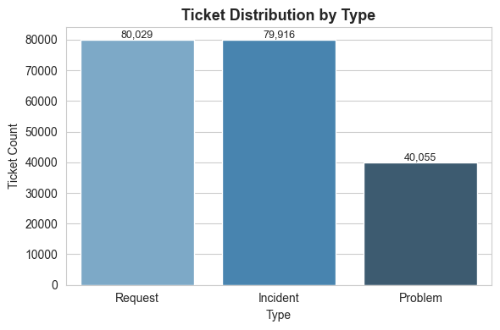
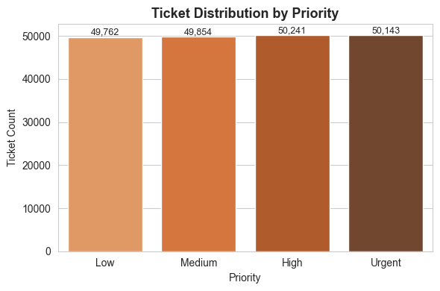
MODULE 3 — EXPLORATORY DATA ANALYSIS
Ticket Volume: Type & Priority
Business questions: which ticket types occur most, and which priorities dominate?
Type: Request 40.0% (80,029) · Incident 40.0% (79,916) · Problem 20.0% (40,055). Priority: essentially even — High 25.1%, Urgent 25.1%, Medium 24.9%, Low 24.9%. No single priority dominates demand.
Supportlytics · Modules 1–8 Journey
7

Slide 8
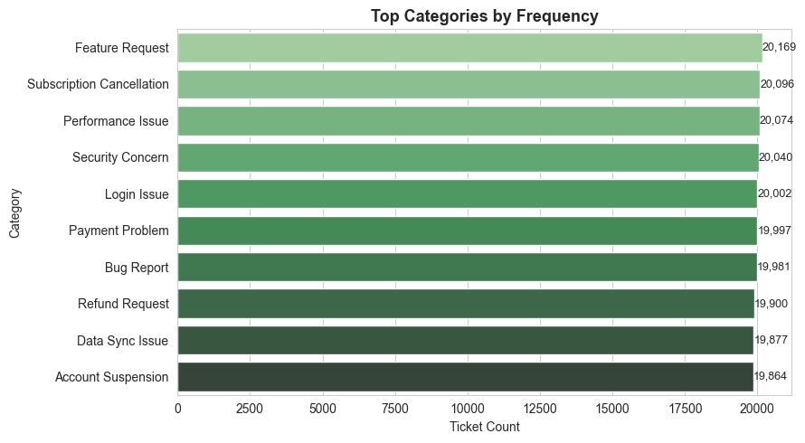
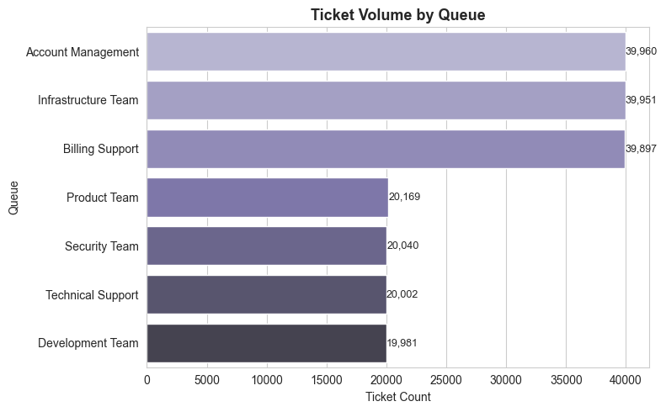
MODULE 3 — EXPLORATORY DATA ANALYSIS
Workload: Category & Queue
Business questions: which categories generate the highest volume, and which queues receive the most tickets?
queue_map = {'Login Issue': 'Technical Support', 'Bug Report': 'Development Team', 'Payment Problem': 'Billing Support', ...} # 10 categories -> 7 queues
Supportlytics · Modules 1–8 Journey
8

Slide 9
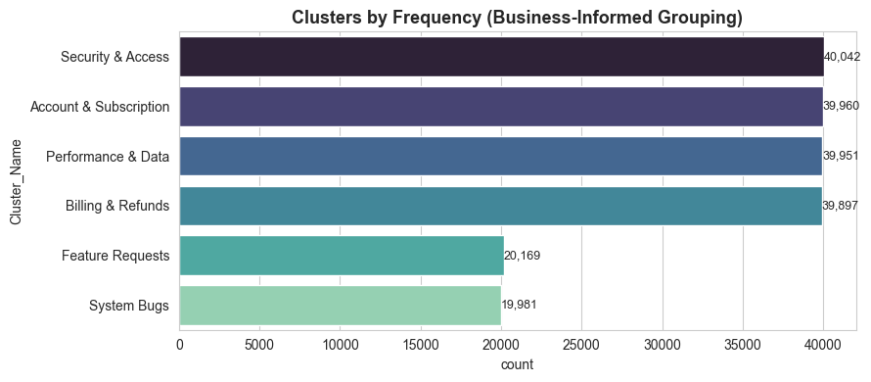
MODULE 4 — BUSINESS CLUSTERING & SIMILARITY ANALYSIS
Business-Informed Clustering
TF-IDF text vectorization combined with predefined business mappings groups related tickets and scores similarity.
tfidf = TfidfVectorizer(max_features=300,
stop_words='english', min_df=5)
tfidf_matrix = tfidf.fit_transform(
df['issue_description'].fillna(''))
>>> 200,000 tickets x 50 terms
category_description = {
'Login Issue': 'Security & Access',
'Payment Problem': 'Billing & Refunds', ... }
df['Cluster_Name'] = df['category'].map(category_description)
6 business-informed clusters
Login Issue, Security Concern
→
Security & Access
Account Suspension, Subscription Cancellation
→
Account & Subscription
Payment Problem, Refund Request
→
Billing & Refunds
Performance Issue, Data Sync Issue
→
Performance & Data
Bug Report
→
System Bugs
Feature Request
→
Feature Requests
Supportlytics · Modules 1–8 Journey
9

Slide 10
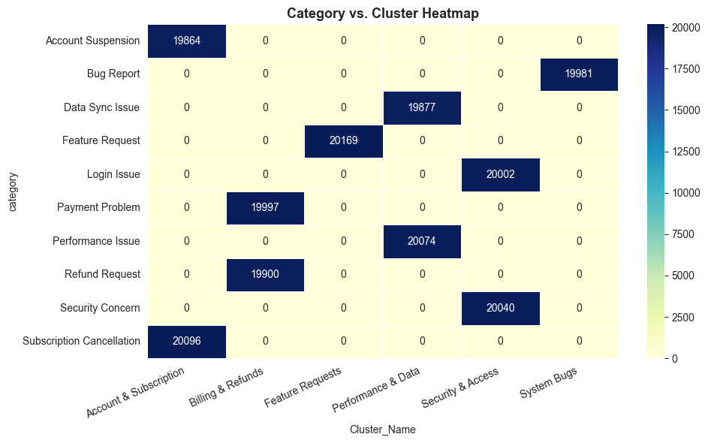
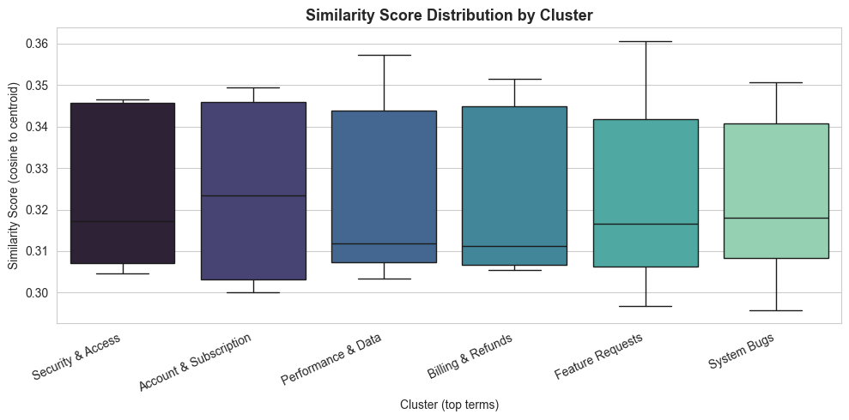
MODULE 4 — BUSINESS CLUSTERING & SIMILARITY ANALYSIS
Cluster Quality & Category Alignment
Cosine similarity to each cluster's centroid confirms internal consistency; the heatmap confirms clean 1:1 category alignment.
Similarity scores cluster tightly around 0.30–0.35 for every group, and the category × cluster heatmap shows each of the 10 categories maps to exactly one cluster — validating that the manual business mapping produces clean, non-overlapping groups.
Supportlytics · Modules 1–8 Journey
10

Slide 11
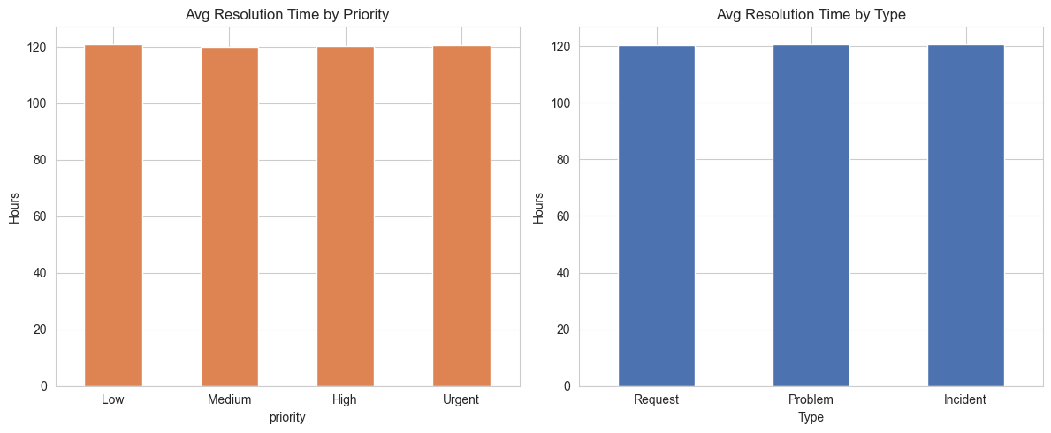
MODULE 5 — PERFORMANCE TREND ANALYSIS · MILESTONE 3
Resolution Time by Priority & Type
Does urgency actually change how fast a ticket gets resolved?
Code
df.groupby('priority')
['resolution_time_hours']
.mean()
df.groupby('Type')
['resolution_time_hours']
.mean()
120
hours, ± 1%
Resolution time barely moves across Low → Urgent or Request/Problem/Incident.
Key insight
Urgent tickets (120.71 hrs) resolve no faster than Low-priority ones (121.03 hrs). Priority labels aren't changing operational behavior — this points to a triage process gap rather than a capacity problem, and is the single most actionable finding in the project.
Supportlytics · Modules 1–8 Journey
11

Slide 12
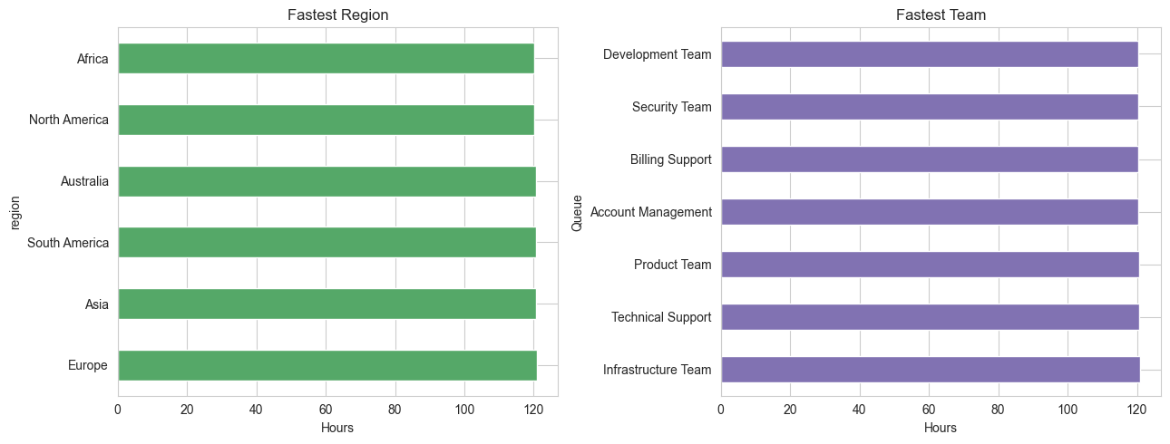
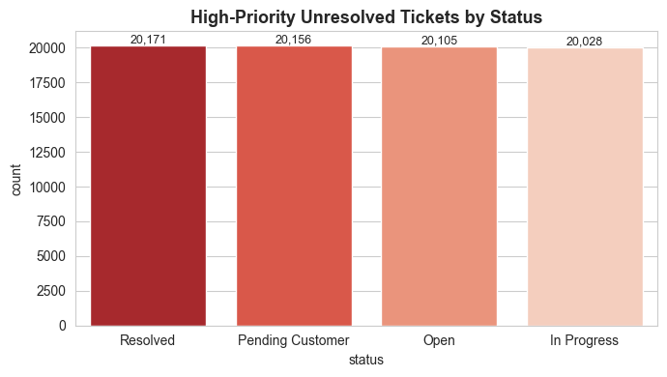
MODULE 5 — PERFORMANCE TREND ANALYSIS · MILESTONE 3
Regional Speed & Backlog Risk
Which regions and teams handle tickets fastest — and how big is the unresolved high-priority backlog?
80,460
High-priority tickets still unresolved — 40.23% of the entire dataset
Reading the regional/team spread
Region: Africa & North America fastest (120.21 hrs), Europe slowest (120.92 hrs) — a gap of under half an hour on a 5-day process. Team: Development Team fastest (120.32 hrs), Infrastructure Team slowest (120.87 hrs). Backlog: 40.23% of all tickets are High/Urgent priority and not yet Closed — the single largest operational risk surfaced in this project.
Supportlytics · Modules 1–8 Journey
12

Slide 13
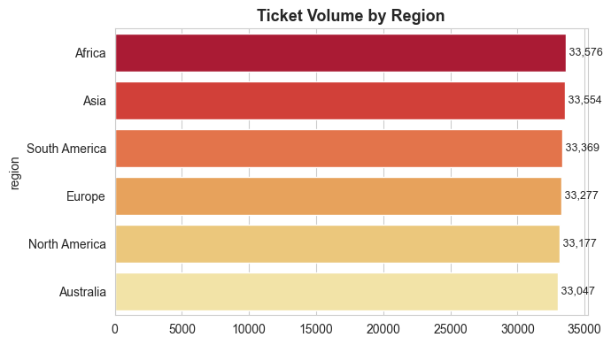
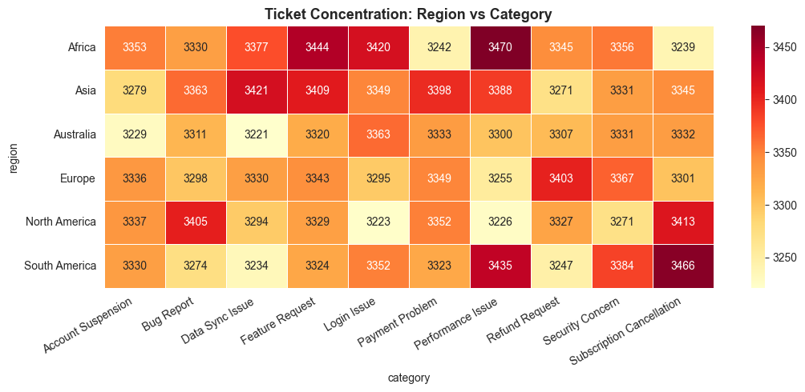
MODULE 6 — GEOGRAPHIC & CATEGORY-LEVEL INSIGHTS · MILESTONE 3
Regional & Category Concentration
Is any single region or category driving the workload — or is demand evenly spread?
~33,300
tickets per region on average — a band of under 2% from lowest (Australia) to highest (Africa). No regional hotspot.
Region × category volume is uniform too — this is a global process characteristic, not a location-specific one.
Supportlytics · Modules 1–8 Journey
13

Slide 14
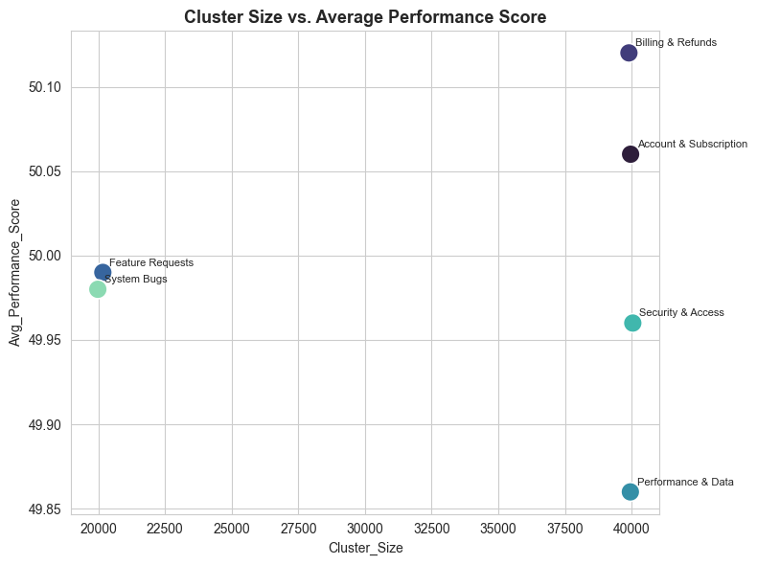
MODULE 6 — GEOGRAPHIC & CATEGORY-LEVEL INSIGHTS · MILESTONE 3
The Performance Score Model
A single composite score blends speed, satisfaction and SLA adherence to rank clusters.
Performance_Score =
Speed
40%
Satisfaction
40%
SLA adherence
20%
speed = 100 * (1 - (t - t.min())/(t.max()-t.min()))
satisfaction = (csat_score - 1) / 4 * 100
sla = (sla_breached == 'No').astype(int) * 100
Performance_Score = (
speed * 0.4 +
satisfaction * 0.4 +
sla * 0.2 )
Correlation (cluster size vs. performance): 0.085 — essentially zero. Bigger clusters (Security & Access, Account & Subscription) perform no better or worse than smaller ones (Feature Requests, System Bugs) — team/queue size isn't the lever to pull.
Supportlytics · Modules 1–8 Journey
14

Slide 15
MODULE 7 — DASHBOARD / REPORT PREPARATION · MILESTONE 4
From Notebook to Power BI
Every module's output feeds a 7-page Power BI report built on a single 200,000-row analytical table.
01
02
03
04
Introduction
Region Insights
Cluster Analysis
Category Trends
Project & KPI context
Geographic performance
Business issue families
Category resolution & CSAT
05
06
07
final_file
Priority & Type
Team & Queue
Overview
200,000 rows × 45 cols · 20 DAX measures
Urgency classification
Operational ownership
Executive synthesis
Design principles: consistent KPI definitions across pages · date-based filtering everywhere · executive-to-operational drill-down · shared business terminology from Modules 1–6.
This deck vs. the dashboard deck
This deck walks the full analytical journey — Modules 1 through 8, cleaning through clustering through the dashboard itself. The companion Dashboard deck goes page-by-page through all 7 Power BI pages in full KPI and chart detail.
Supportlytics · Modules 1–8 Journey
15

Slide 16
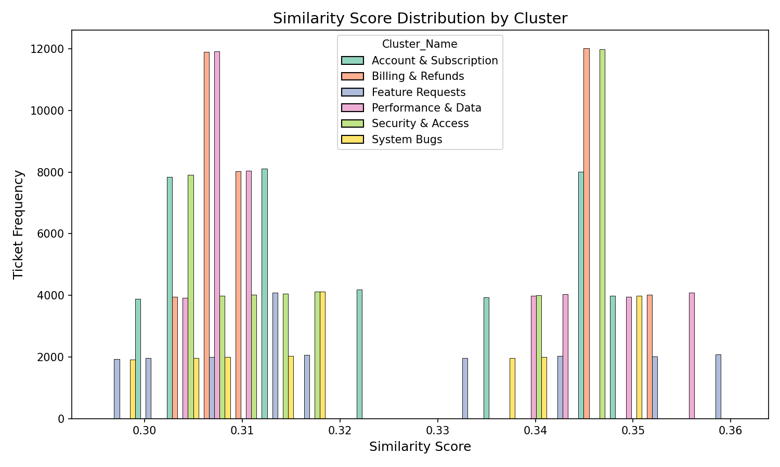
MODULE 7 — DASHBOARD / REPORT PREPARATION · MILESTONE 4
Executive KPIs, Powered by Python Inside Power BI
The dashboard's KPI cards and one of its charts both trace directly back to this project's Python pipeline.
Same pipeline, two surfaces
200,000
120.54 hrs
8.93%
50.21%
40%
# Runs live inside the Power BI visual
sns.histplot(data=dataset,
x='Similarity_Score',
hue='Cluster_Name',
multiple='dodge')
Total Tickets
Avg Resolution
SLA Compliance
Escalation Rate
CSAT
Live Python visual — this seaborn chart runs inside the Power BI report itself, reading the same final_file table
Notebook → Dashboard
The same Module 4 clustering logic that ran in Jupyter for offline analysis is embedded as a live Python visual in Power BI — so the similarity distribution refreshes with the data instead of being a static export.
This is the direct link between this deck's Python work and the dashboard deliverable.
Supportlytics · Modules 1–8 Journey
16

Slide 17
MODULE 8 — DOCUMENTATION & PRESENTATION · MILESTONE 4
What Was Delivered
Every module produced a concrete artifact — nothing lives only as a chart on a screen.
Jupyter Notebook
Cleaned Datasets
Supportlytics.ipynb — 49 cells, all 8 modules, code + charts + findings
CSV exports after Module 2 (33 cols) and Module 4 (37 cols)
Power BI Report
Word Documentation
Supportlytics__dashboard.pbix — 7 pages, 20 DAX measures, 2 live Python visuals
Full milestone write-up — objectives, methodology, outputs per module
Dashboard Deck
This Deck
12-slide walkthrough of every Power BI page with real KPI values
20-slide, first-to-last project narrative for presentation
Supportlytics · Modules 1–8 Journey
Supportlytics · Modules 1–8 Journey
17
17

Slide 18
SYNTHESIS
Key Business Insights
1
2
3
Triage isn't working
The backlog is the real risk
SLA compliance is very low
Urgent tickets resolve in 120.7 hrs vs. 121.0 hrs for Low priority — a gap of under 20 minutes. Priority labels don't change what actually happens operationally.
40.23% of all tickets — 80,460 of them — are High/Urgent priority and still not Closed. This dwarfs every regional or team-level variance in the data.
Only 8.93% of tickets resolve within their SLA target hours, despite priority and region showing almost no difference in speed — a systemic issue, not a local one.
4
5
6
Size doesn't predict performance
No geographic hotspot
Escalation is a coin flip
Correlation between cluster size and performance score is 0.085 — essentially zero. Bigger queues (40K tickets) don't outperform or underperform smaller ones (20K).
All 6 regions sit within ~1% of each other on both volume and resolution speed. This is a process-design issue, not a staffing-location issue.
50.21% escalation rate combined with flat resolution times suggests escalation criteria may not be tied to actual urgency or complexity.

Slide 19
SYNTHESIS
Recommendations
Four concrete, data-backed actions — each tied directly to a finding from Modules 5–6.
01
02
Rebuild the triage workflow
Attack the High-priority backlog first
Since priority doesn't change resolution speed today, introduce an SLA-linked queue that actually fast-tracks Urgent/High tickets — the current system exists in name only.
80,460 unresolved High/Urgent tickets is the single biggest lever in this dataset. A focused backlog sprint would outperform any regional or team reallocation.
03
04
Standardize globally, not regionally
Track the dashboard's core KPIs monthly
With all 6 regions performing within ~1% of each other, process fixes should roll out company-wide — regional pilots would miss the point.
Use the Power BI report's SLA Compliance, Escalation Rate and Backlog cards as the standing scorecard for whether these changes are working.
Supportlytics · Modules 1–8 Journey
19

Slide 20
CONCLUSION
Next Steps
From raw tickets to an executive dashboard
1
Pilot the SLA-linked triage queue
Test on one team/queue before a company-wide rollout
2
Stand up a backlog burn-down
Eight modules, one 200,000-row dataset, and a single consistent story: support demand is stable and predictable — the response process is where the opportunity is.
Weekly tracking of the 80,460 unresolved High/Urgent tickets
3
Automate the Power BI refresh
Schedule dataset refresh so KPI cards stay current, not static
4
Re-run Module 5–6 analysis quarterly
Confirm whether the flat resolution-time pattern persists post-fix
Prepared by N Sai Srimannarayana
Supportlytics — Data-Driven Optimization of IT Support Team Performance
20

